Slide 1
Solar Charger Project
Dominick Christensen

Slide 2
Motivation
Something somebody could use
My dad has no respect for battery life
I needed to do something

Slide 3
Objective
Portable Solar Phone/Battery Charger
Controlled by Arduino
Regulate 12V to 5V
Charge Phone via USB
Long Term (Stretch) Goals
Durable
Make Dad Proud

Slide 4
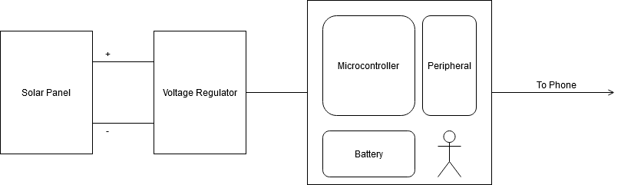
Basic Concept

Slide 5

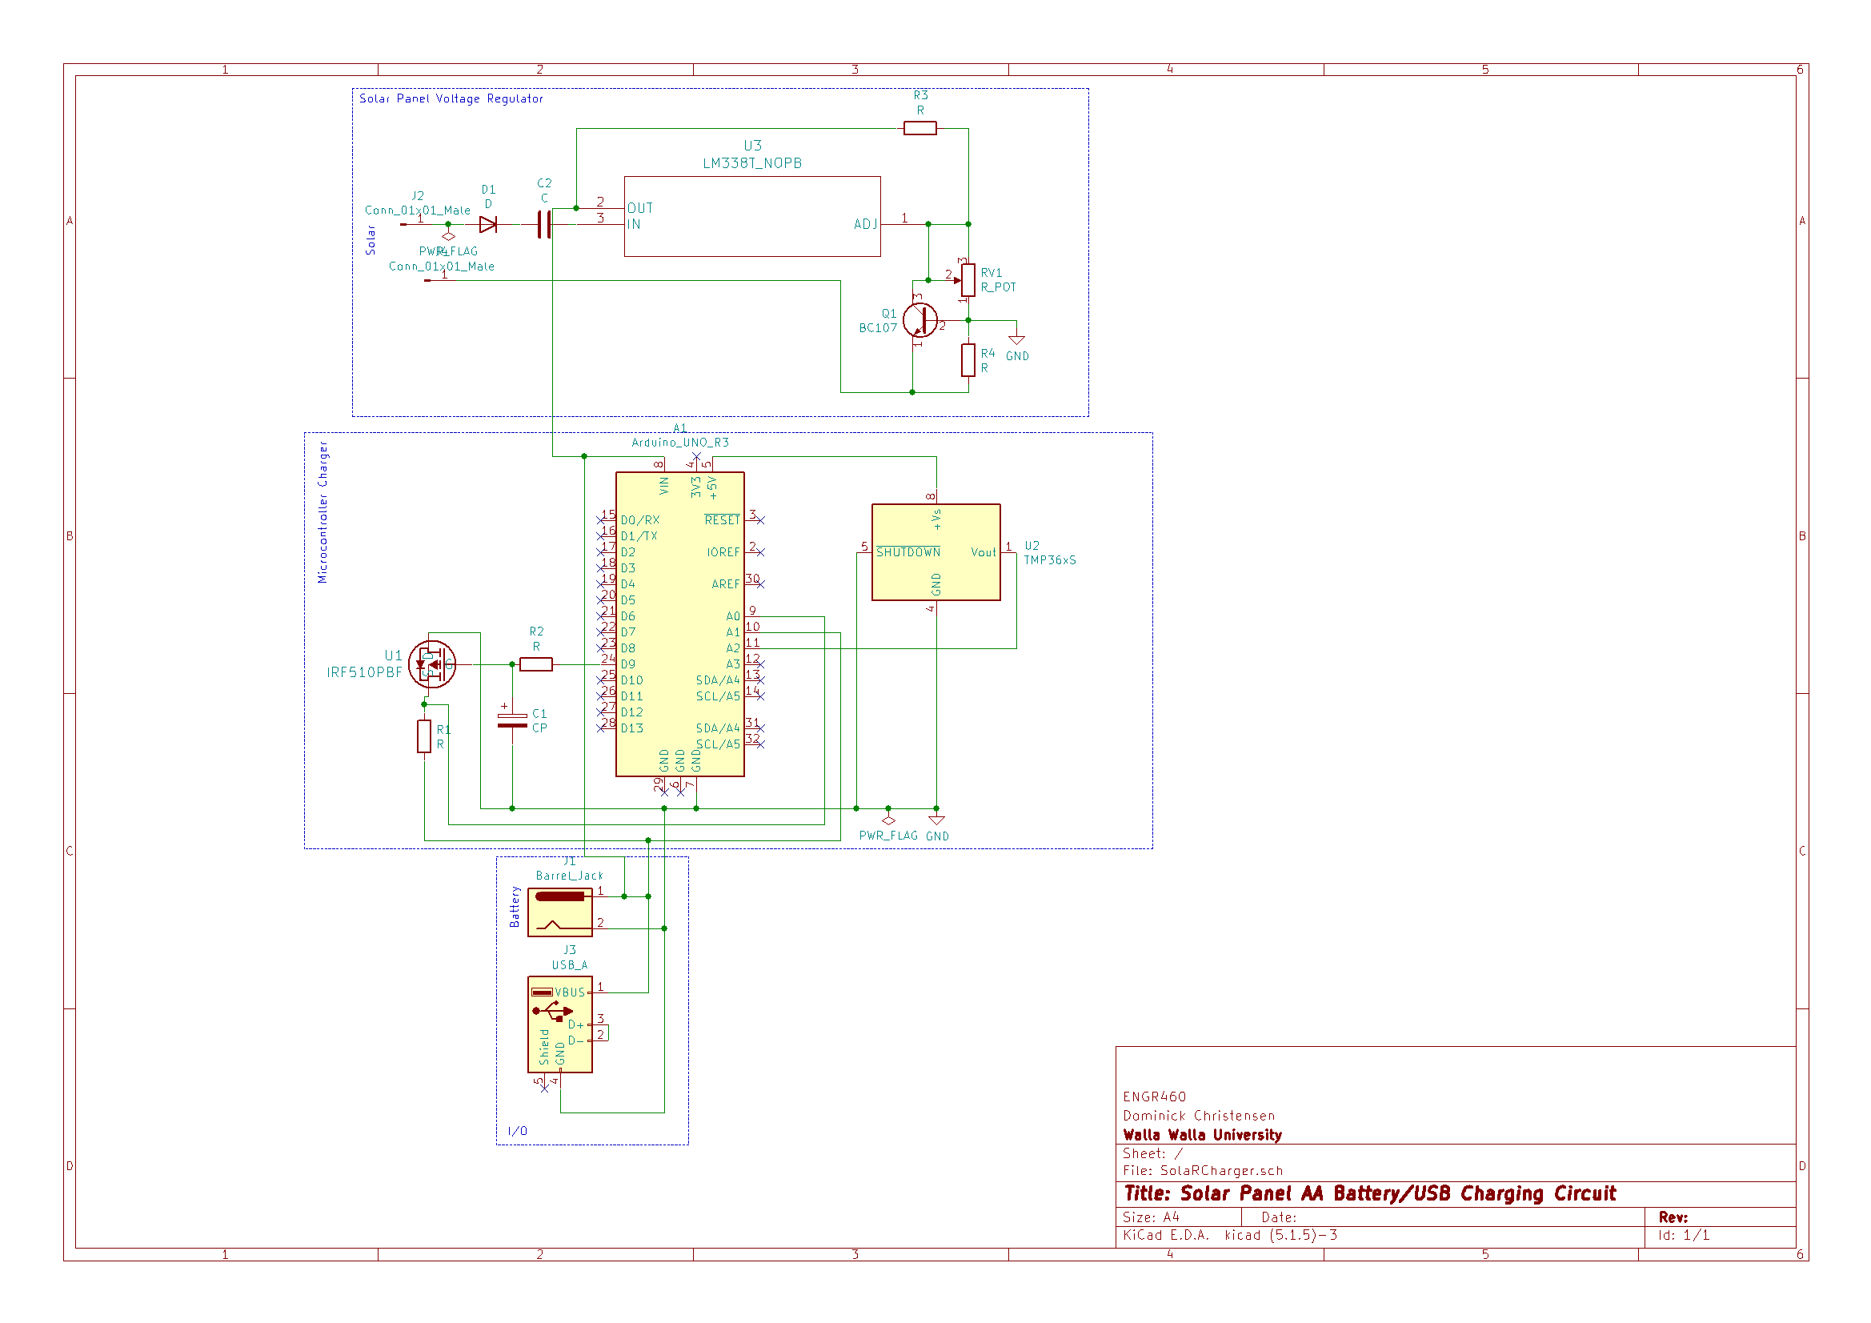

Slide 6
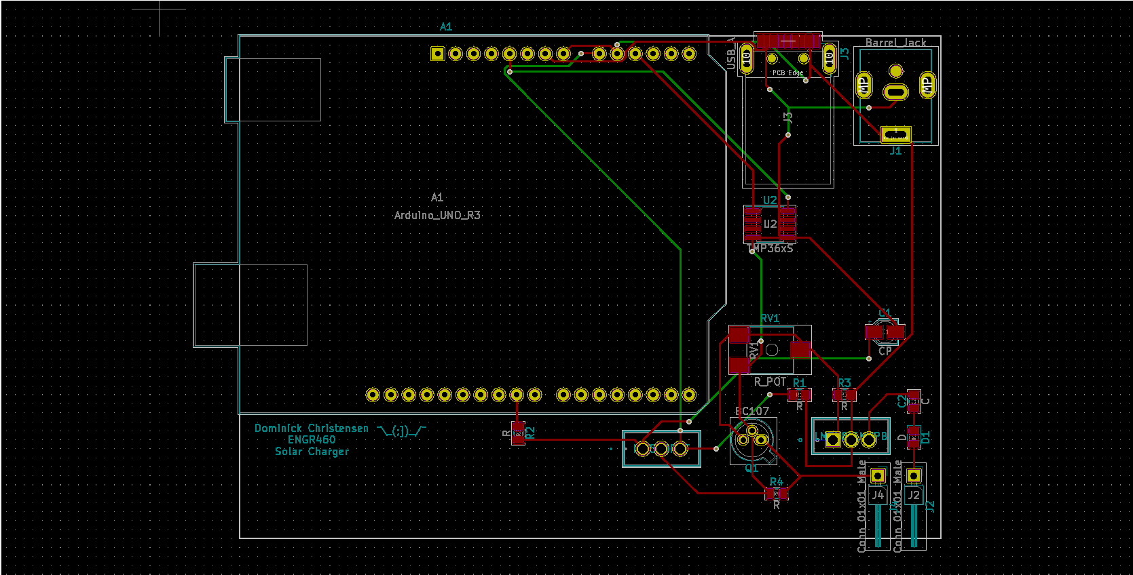

Slide 7
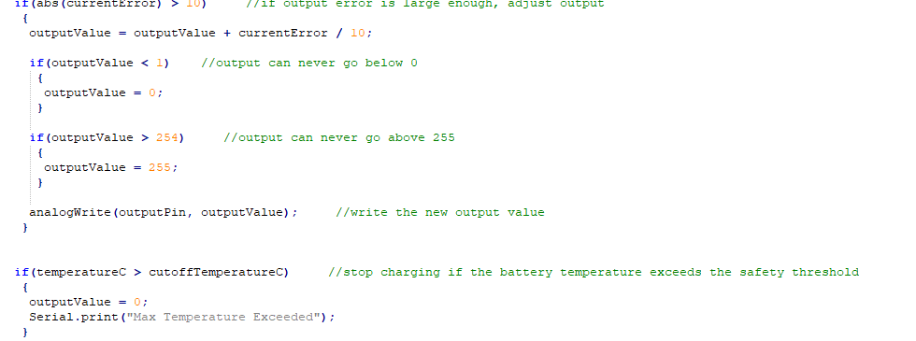
Code

Slide 8
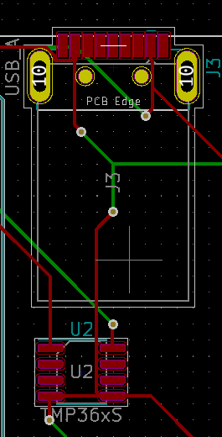
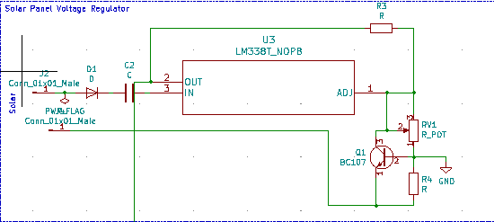

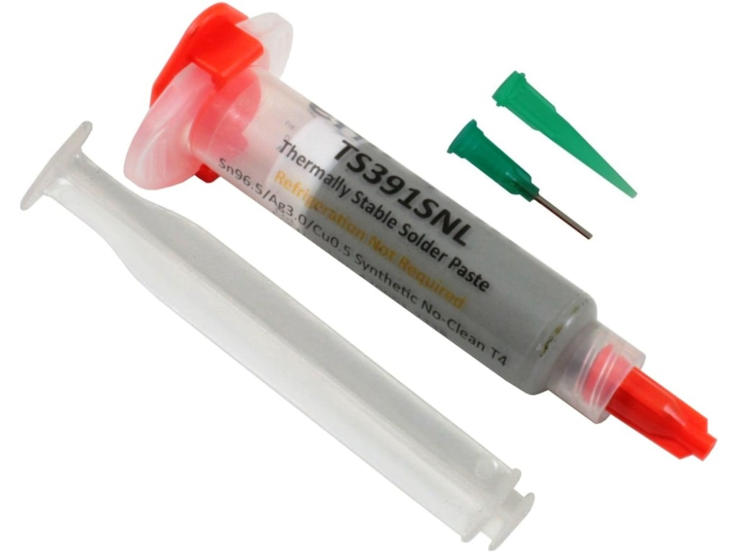
Build/Testing
Problematic
Burned some key components
Hasn’t been cleaned in generations
Could been better positioned

Slide 9
Closing Thoughts
Develop Code Test Bench
Design PCB to be modular
Build Enclosure

Slide 10

Questions?

